Slide 1
Elementary and Secondary School Emergency Relief (ESSER) Roundtable Series: Overview of the ESSER Funds
New Jersey Department of Education
Division of Educational Services
October 20, 2021

Slide 2
Using Microsoft Teams
Chat
We welcome your participation in discussions by asking questions and adding comments in the chat box.
Raise Hand
Please use the raise hand feature if you want to speak.
Mute/Unmute
Please remain muted whenever you are not speaking.

Slide 3
Agenda
Housekeeping Ms. Peggy Porche, Planning Associate, Division of Educational Services, Office of the Executive Director/Deputy Assistant Commissioner
Welcome Dr. A. Charles Wright, Executive Director/Deputy Assistant Commissioner, Division of Educational Services
Overview Mrs. Kathleen Ehling, Assistant Commissioner, Division of Educational Services
Frequently Asked Questions Dr. A. Charles Wright, Executive Director/Deputy Assistant Commissioner, Division of Educational Services
District Presentations
Clifton Public School District
Dr. Danny A. Robertozzi, Superintendent of Schools
Janina J. Kusielewicz, Assistant Superintendent for Curriculum and Instruction
Red Bank Borough Public School District
Luigi Laugelli, Assistant Superintendent of Curriculum & Instruction
Northern Burlington County Regional School District
Dr. Amy Stella, Director, Curriculum, Instruction and Professional Development

Slide 4
Overview of Federal Relief Funds
New Jersey received over $4 billion in Federal emergency funds including:
ESSER I
$310,371,213
ESSER II
$1,230,971,757
ARP ESSER
$2,766,529,533
ARP IDEA
$79,863,122
ARP HCY
$18,118,224

Slide 5
ESSER Overview
The Elementary and Secondary School Emergency Relief (ESSER) Fund was established by law in March 2020 with the overall purpose of providing school districts, or Local Educational Agencies (LEAs) with emergency relief funds to prevent, prepare for, or respond to the COVID-19 pandemic, including its impact on the social, emotional, mental health, and academic needs of students.

Slide 6
ESSER I (CARES Act)
Coronavirus Relief and Economic Security Act (CARES)
Passed in March 2020
Created the “Education Stabilization Fund”
Funded the Elementary & Secondary Schools Emergency Relief Fund (ESSER) and the Governor’s Emergency Education Relief Fund (GEER)
New Jersey received $310,371,213 in ESSER Funds

Slide 7
ESSER II (CRSSA Act)
Coronavirus Response and Relief Supplemental Appropriations Act (CRRSA)
Passed in December 2020
Further funded the Elementary & Secondary Schools Emergency Relief Fund (ESSER) and the Governor’s Emergency Education Relief Fund (GEER)
New Jersey received $1,230,971,757 in ESSER II Funds
Created the Emergency Assistance to Non-Public Schools (EANS) Program

Slide 8
ESSER III (ARP)
American Rescue Plan Act (ARP)
Passed in March 2021
Provided $122 billion nationwide for ESSER
NJ received $2,766,529,533 in ARP ESSER Funds
Required states to submit a plan to the United States Department of Education for approval

Slide 9
ARP ESSER: New Jersey Details
NJ’s Total ARP ESSER Allocation:
$2,766,529,533
Minimum Direct to LEAs (90%)
$2,489,876,580
Develop Plan for Safe Return to In-Person Instruction
At least 20% for learning loss activities that address social, emotional, and academic needs and disproportionate impact on subgroups
Remaining 80% on wide range of activities: special emphasis on implementing public health protocols consistent with CDC guidance
Maximum State Set-Aside (10%)
$276,652,953
Acceler-ated Learning
(5%)
Beyond School Day
(1%)
Summer
(1%)
NJTSS
(2.5%)
Admin.
(0.5%)

Slide 10
Period of Funds Availability
ESSER I, II and III (ARP ESSER) may be used for pre-award costs dating back to March 13, 2020, when the public emergency was declared. Funds are available for obligation:
ESSER I through September 30, 2022.
ESSER II through September 30, 2023.
ESSER III through September 30, 2024.
This includes the 12 month Tydings period.

Slide 11
Equitable Services
For ESSER I, an LEA that received funds must provide equitable services to non-public school students in the same manner as provided for under section 1117 of Title I, Part A of the ESEA.
For ESSER II and III, equitable services are being provided under a separate program, “Emergency Assistance for Non-Public Schools” (EANS).

Slide 12
Allowable Uses of Funds

Slide 13
Allowable Uses
Allowable under ESSER I, ESSER II, and ARP ESSER:
Anything authorized by ESSA, IDEA, AEFLA, Perkins, and McKinney-Vento
Coordination of COVID preparedness and response efforts
Activities for low-income, SWD, EL, racial and ethnic minorities, homeless, and foster
Developing and implementing procedures and systems
Training and PD on minimizing spread of infectious diseases
Purchasing supplies to sanitize and clean
Planning for, coordinating, and implementing activities, incl. meals
Technology for students and staff
Mental health services and supports
Summer learning and supplemental afterschool programs
Providing principals with resources necessary to address individual needs of schools
Implementing public health protocols
Addressing learning loss (assessments, evidence-based activities, parents, attendance)
School facility repairs to reduce risk of virus transmission
Air quality improvements
Other activities that are necessary to maintain operation and keep staff employed
Credit Massachusetts Department of Public Instruction: https://www.doe.mass.edu/federalgrants/esser/esser3-webinar.pdf

Slide 14
ARP ESSER Use of Funds Requirements
LEAs must reserve at least 20% of funds to address learning loss through implementation of evidence-based interventions and ensure that those interventions respond to students’ social, emotional, and academic needs and address the disproportionate impact of COVID-19 on underrepresented students subgroups:
Each major racial and ethnic group
Children from low-income families
Children with disabilities
Children and youth in foster care
English learners
Gender
Migrant students
Students experiencing homelessness

Slide 15
ARP ESSER LEA Use of Funds Plan
Under an interim final rule published by the US Department of Education each LEA that receives ARP ESSER funds:
Must develop and submit to the State; and
Make publicly available a plan for the use of the LEA’s ARP ESSER funds

Slide 16
Frequently Asked Questions

Slide 17
Allowable Uses How do I know if a cost is an allowable use of ESSER funds?
Generally, in determining whether an activity is an allowable use of funds, a school district must determine:
Is the use of funds intended to prevent, prepare for, or respond to the COVID-19 pandemic, including its impact on the social, emotional, mental health, and academic needs of students?
Does the use of funds fall under one of the authorized uses of ESSER or GEER funds?
Is the use of funds permissible under the Uniform Administrative Requirements, Cost Principles, and Audit Requirements for Federal Awards (Uniform Guidance, 2 CFR Part 200)?

Slide 18
Uniform Guidance
Do the requirements in the Uniform Guidance apply to expenditures of ESSER funds?
Yes, specific uses of ESSER funds must comply with the Cost Principles in subpart E of 2 CFR Part 200 of the Uniform Guidance. This requires, among other things, that every grant expenditure by necessary and reasonable to carry out the performance of the grant.

Slide 19
EWEG
How do I apply for ESSER funds and when is the due date for my application?
All three ESSER grant applications (ESSER I, II and ARP ESSER) are available through the Electronic Web-Enabled Grant System (EWEG). The due date for the ARP ESSER application is November 24, 2021.

Slide 20
Supplement not Supplant
Is there a “supplement not supplant” requirement for ESSER funds?
No, there is no supplement not supplant requirement for any of the ESSER funds.

Slide 21
Testing and Vaccinations
May ESSER funds be used for COVID-19 testing or for providing COVID-19 vaccinations for eligible students, teacher and school staff?
Yes, Because ESSER and GEER funds may be used for public health protocols including, to the greatest extent practicable, policies in line with guidance from the CDC for the reopening and operation of school facilities to effectively maintain the health and safety of students, educators, and other staff, providing COVID-19 testing and/or COVID-19 vaccinations is an allowable use of ESSER and GEER funds.

Slide 22
District Presentations

Slide 23
Clifton Public School District

Slide 24
Clifton Public Schools: Leveraging ESSER and Federally Funded Summer Programs
NJDOE ARP ESSER Round Table—October 20, 2021
Dr. Danny A. Robertozzi, Superintendent of Schools
Janina J. Kusielewicz, Assisstant Superintendent for Curriculum

Slide 25
Return to In-Person Instruction
Leveraging Funding Sources
ESSER
ESEA Title 1, 3 and 4
Utilizing Best Practices
Focus on the Whole Child
Programs for ALL Students
Family Outreach

Slide 26
Integrated PK-12 Program Offerings
Academic Readiness and JumpStart from PK and Kindergarten
Summer Acceleration and Student Support K-5
Middle School Academy 6-8
Programs for English Language Learners K-12
Extended School Year PK-12
Covid Learning Support PK-12
High School Acceleration and Credit Recovery 9-12
Academic AP Advacement

Slide 27
SEL Focus For Return to School
Students engaged in social, emotional, behavioral and academic readiness skills and practices that prepared them for return to school
Positive Behavioral Supports in Schools (PBSIS) is employed district wide to re-establish and re-teach school expectations, routines and behaviors
Social and academic “skill-building” groups with counselors
Opportunities to practice school expectations and interactions in a developmentally and grade appropriate manner
Focus on re-engaging ALL learners

Slide 28
Elementary Priorites
Language Arts –
Grades K-2 focused on remediating and enriching the NJSLS for Reading Foundational Skills. Students worked to solidify high frequency words, phonemic awareness, comprehension and fluency skills.
Grades 3-5 focused on remediating and enriching the NJSLS for Writing , Reading Literature, and Reading Information Text specific to Science and STEM topics. Students worked to solidify skills, strategies, comprehension, and fluency.
Mathematics and STEM –
Grades K-5 focused on remediating and reinforcing the essential skills of the previous grade, while also accelerating students to a level of proficiency that will enable them to master the readiness skills needed for success at the next grade level.
A center based, individualized hands on approach to learning was used to provide engaging lessons that connecting Math, Literacy, Science, and STEM concepts

Slide 29
Secondary Priorites
Language Arts – Students received instruction to reinforce essential skills in Reading and Writing with a focus on non-fiction Science and STEM topics
Reinforced skills using NJSLS in the areas of: Reading Literature, Reading Informational Text, Speaking & Listening, Language, Foundational skills, and Writing
Mathematics – Targeted major content from the NJSLA providing individualized hands on lessons building on student end of year local assessments
STEM – Incorporated hands on STEM projects which had students creating food menus, designing brochures for the businesses, designing a product or prototype, budgets for food, and a sales pitch for their businesses. These problem based learning projects drew on cross content understanding and asked students to apply their knowledge to the real world.

Slide 30
High School Priorites
Small group, short term in-person and virtual groups were provided for varied Language Arts, Math and Science courses
Preparation courses to accelerate learning for Advanced Placement course was provided
Traditional credit recovery courses available for students requiring intensive support
English Language Learners and students with special needs provided extended summer programs
Counseling services were expanded and available for all students

Slide 31
Engaging Students and Families
Assemblies enriched Elementary programs and made community connections
Breakfast and Lunch provided to all students through USDOA Waiver
Family Literacy program providing ESL classes and community resources provided
Parent involvement increased through virtual and in person meets

Slide 32
Red Bank Borough Public School District

Slide 33
NJDOE ARP ESSER Round Table – Summer Programming 2021
NJDOE ARP ESSER Round Table – Summer Programming 2021
Wednesday, October 20, 2021
Luigi Laugelli Assistant Superintendent of Curriculum & Instruction laugellil@rbb.k12.nj.us | @DreamBigRB

Slide 34
What Do We Believe In?
OUR MISSION
Driven by the needs of our children, we provide a safe, nurturing and challenging learning environment for every student every day.
OUR VISION
We believe our children should Dream BIG. We will inspire. We will challenge. They will achieve.
Dream BIG… We’ll Help You Get There!

Slide 35
Quote
35 Dream BIG… We’ll Help You Get There!

Slide 36
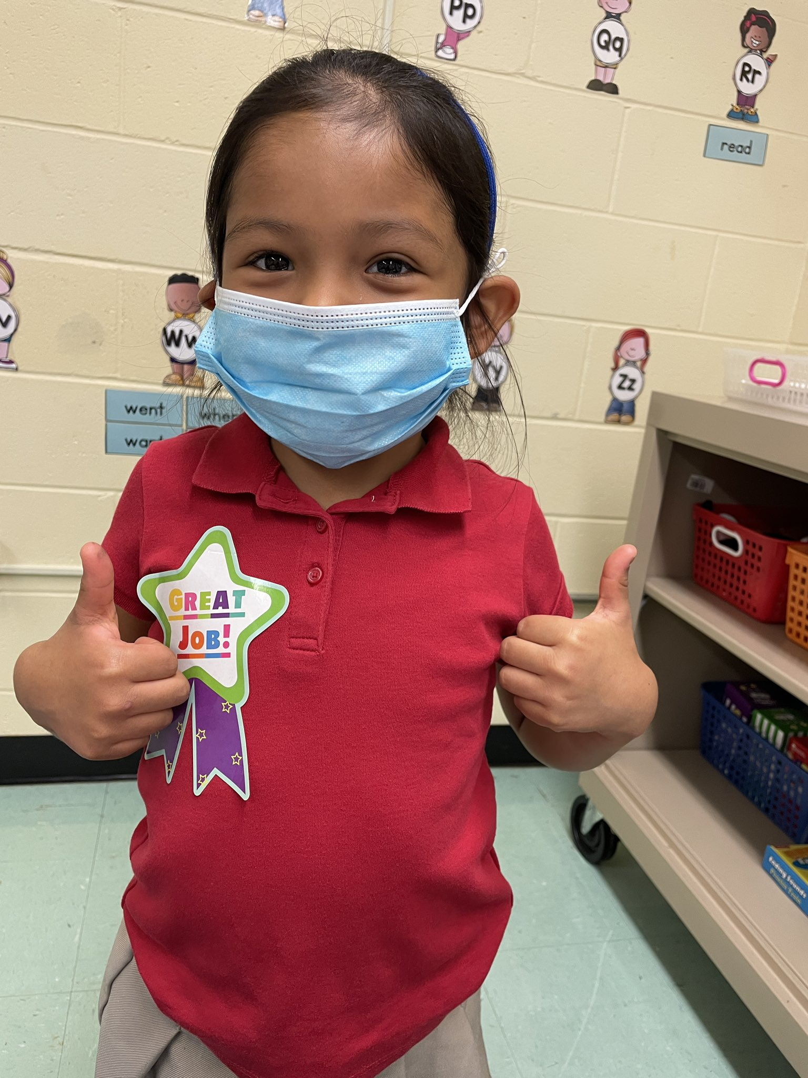
Prior to Summer Learning 2021
Funding Review
Staff Survey
Student/Family Survey & Updates
Facility Review
Health & Safety Review
Community Partner Meetings
36 Dream BIG… We’ll Help You Get There!

Slide 37
Summer Learning 2021 - Innovation
What INNOVATIVE ways did we utilize ESSER funds to plan, develop and implement Summer 2021?
Collaboration with Community Partners (In-Person)
Project Write Now (Summer Writing)
Count Basie Center for the Arts (40+ Sessions in VPA)
Jazz Arts Project (Instrumental & Band Lessons)
Horizons at the Jersey Shore (200 Students – 6 Weeks)
Opportunities for In-Person and Virtual Learning
Summer Book Clubs & Read Alouds/Shared Reading
Math Jump Start & ELL Newcomer Enrichment
Jump Start to Kindergarten (In-Person Program)
Extended School Year (In-Person Program) - Non-ESSER
Preschool – Grade 8 Summer Device & WiFi Usage + Digital Subscriptions
Summer Learning Resources Website
37 Dream BIG… We’ll Help You Get There!

Slide 38
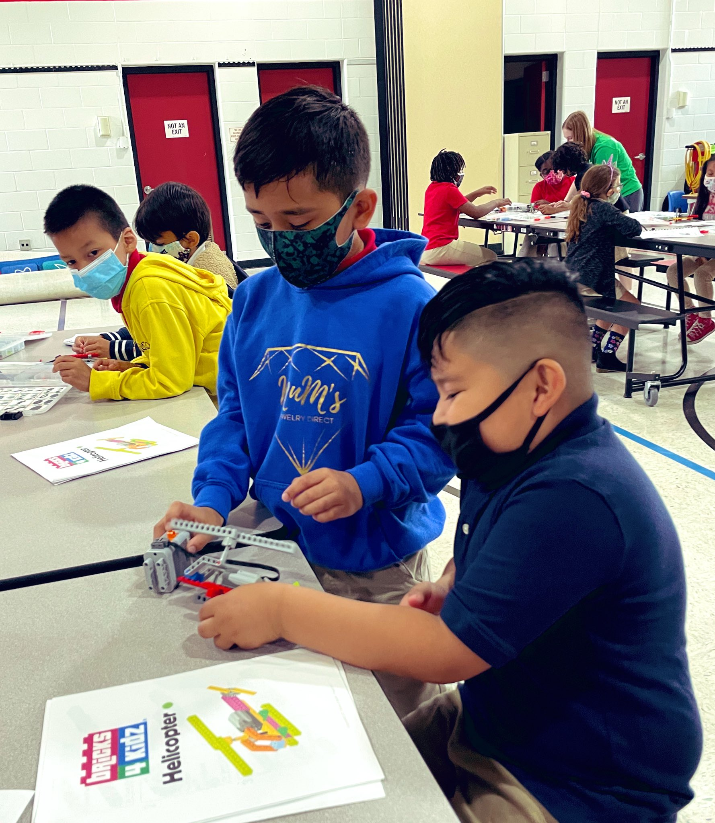
Summer Learning 2021 - Solutions
What unique SOLUTIONS did we utilize to get students and families engaged?
Communication (Systems & Language)
Opportunities for ALL Learners
Teacher-Parent Communication (May/June)
Flexible Schedules
Surveys
Meal Distribution
Visibility & Social Media
38 Dream BIG… We’ll Help You Get There!

Slide 39
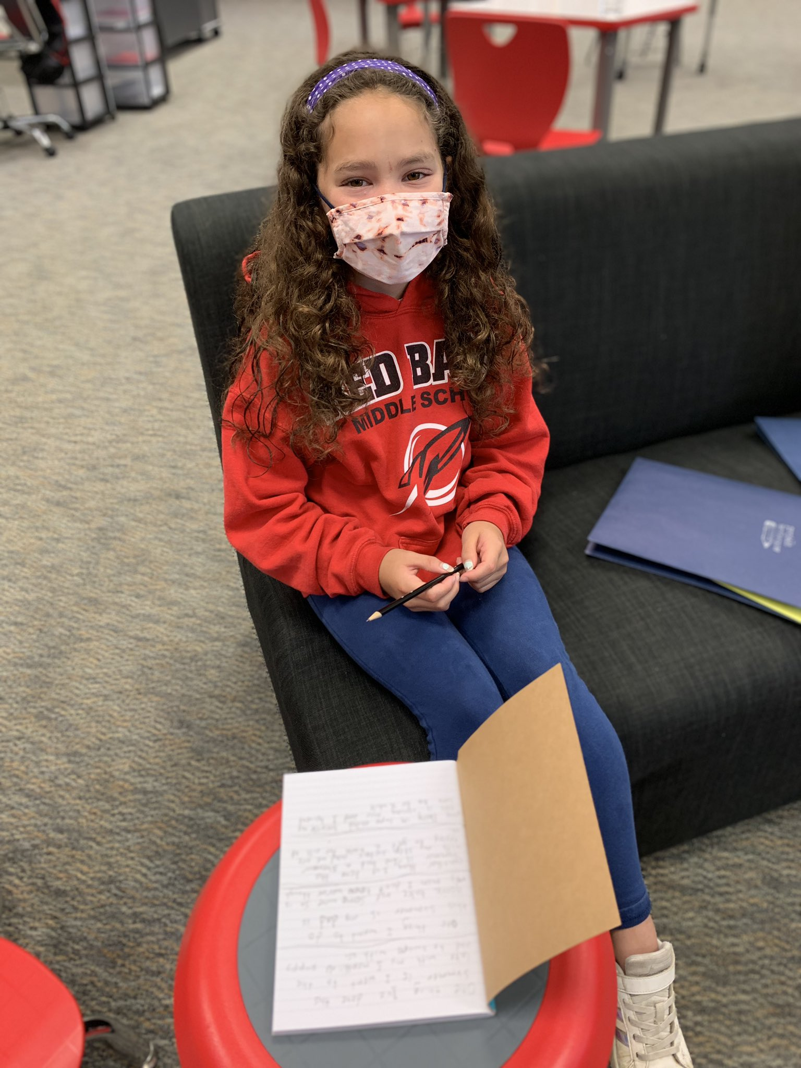
Summer Learning 2021 - Differences
What are the DIFFERENCES between Summer 2021 and other summer programs?
Virtual Sessions
Opportunities for ALL (Includes Special Education & ELL)
No Child Denied
FREE
Transportation (Where Available)
Schedule - Days, Nights & Weekends
39 Dream BIG… We’ll Help You Get There!

Slide 40
Summer Learning 2021 - Outcomes
What were the OUTCOMES achieved?
Easier Transition for Full-Remote Students
Access for ALL
More Opportunities Outside the “9-12” Window
Daily SEL Check-In In ALL Classes
Parent Involvement (Virtual Sessions)
Strengthening Community Partnerships
Increased Student Participation
Increased Technology Proficiency (Students, Staff & Families)
40 Dream BIG… We’ll Help You Get There!

Slide 41
For More Information
Facebook: @RedBankBoroughPublicSchools Twitter: @rbpsEAGLES | @rbmsROCKETS | @RedBankPreK
Twitter & Instagram: @RedBankSup | @DreamBigRB Hashtags: #RBBisBIA | #RBWell | #BestSelf | #LightTheWayNJ
41 Dream BIG… We’ll Help You Get There!

Slide 42
Northern Burlington County Regional School District

Slide 43
Northern Burlington County Regional School District ESSER Funded Enrichment Experiences - Summer 2021
10 enrichment camps to re-acclimate students to school
Each enrichment activity included elements of Math & ELA skills supported by content specialists.
Minecraft
Current Events
Room to Breathe: Mindfulness & Organization
Technology - Cardboard Golf Game Design
Farming & Ecosystem Sustainability
Physics of Flight
Magic the Gathering Strategy & Tabletop Gaming
STEM: Graphic Design
Graphic Novels
History of Sports
Amy Stella, Ed.D., Director of CI&PD

Slide 44
Thank You!
New Jersey Department of Education Website nj.gov/education
Questions may be submitted to:
ESSER@doe.nj.gov
Registration now open for the November 17, 2021, ARP ESSER Round Table
Follow Us!
Facebook: @njdeptofed
Twitter: @NewJerseyDOE
Instagram: @NewJerseyDoe

